Slide 1

Vel Tech Rangarajan Dr. Sagunthala R&D Institute of Science and Technology
School of Computing
Department of Computer Science and Engineering
10211CS224 / FULL STACK APPLICATION DEVELOPMENT (JAVA)
PROJECT REVIEW : MILESTONE PROJECT – 1
Date: 23-03-2026
Academic Campus Event & Registration Portal
SDG:SDG 4 – Quality Education)
Presented By:
L. ADINARAYANA – VTU26080 – 23UECS0790
Courses Handling Faculty:
Dr. HAFIZUR RAHMAN - B.E., M.Tech., Ph.D.
ASSISTANT PROFESSOR

Slide 2
INTRODUCTION
Background of the problem
Traditional campus event management is manual and inefficient, making registration and tracking difficult.
Why this project is important
This project is important because it simplifies event management, saves time, reduces manual errors, and provides a centralized system for students and administrators.
Real-world relevance
It is useful for managing college events like workshops, seminars, fests, and technical programs.
Brief overview of the system
An online portal that allows admins to create events and students to register and manage participation digitally.
1
2
3
4
5
6
7
8
9

Slide 3

PROBLEM STATEMENT
1
In many educational institutions, campus events are managed manually or using basic tools that lack proper automation. This creates difficulties in handling registrations, approvals, attendance tracking, and communication with participants efficiently. Manual management increases paperwork, consumes time, and may lead to data errors or mismanagement. There is a need for a secure and centralized event management system that can streamline event creation, student registration, participant tracking, and automated notifications. Such a system improves efficiency, accuracy, and overall campus event coordination.
2
3
4
5
6
7
8
9

Slide 4
OBJECTIVE(S)
To design and develop a web-based Academic Campus Event & Registration Portal with secure user authentication and role-based access.
To implement online event creation, student registration, participant management, and automated notifications for efficient event coordination.
1
2
3
4
5
6
7
8
9

Slide 5
PROPOSED SYSTEM
The proposed system is a web-based Academic Campus Event & Registration Portal that manages events, users, and registrations in one platform.
It allows students to register for campus events easily through an online interface.
Admin can create, update, and manage events and participant details.
The system tracks registrations and maintains participant records automatically.
It sends notifications or confirmations to registered participants.
It reduces manual paperwork and administrative workload.
It minimizes errors in registration and data management.
It provides a faster and more efficient solution compared to traditional manual systems.
1
2
3
4
5
6
7
8
9

Slide 6
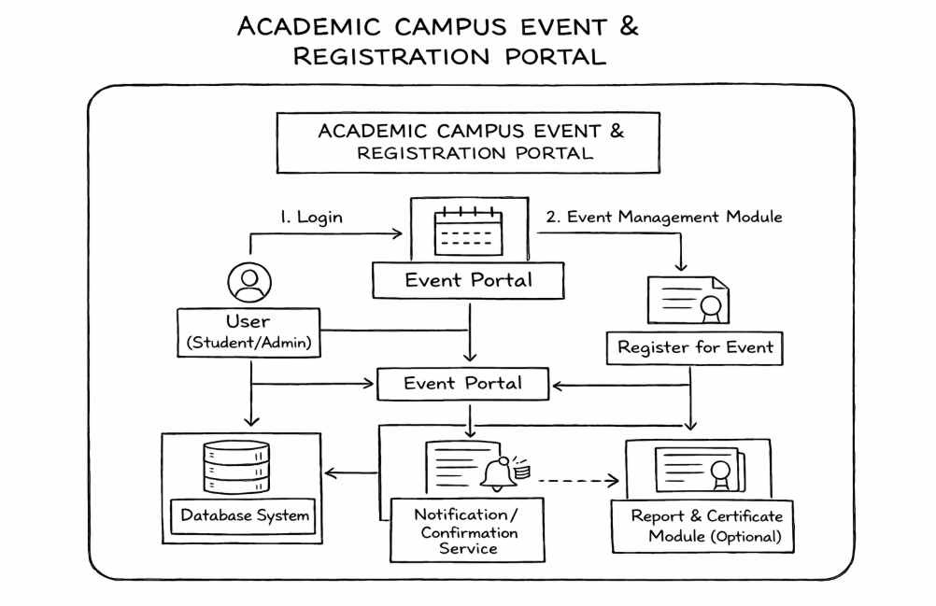
PROPOSED SYSTEM ARCHITECTURE
1
2
3
4
5
6
7
8
9

Slide 7
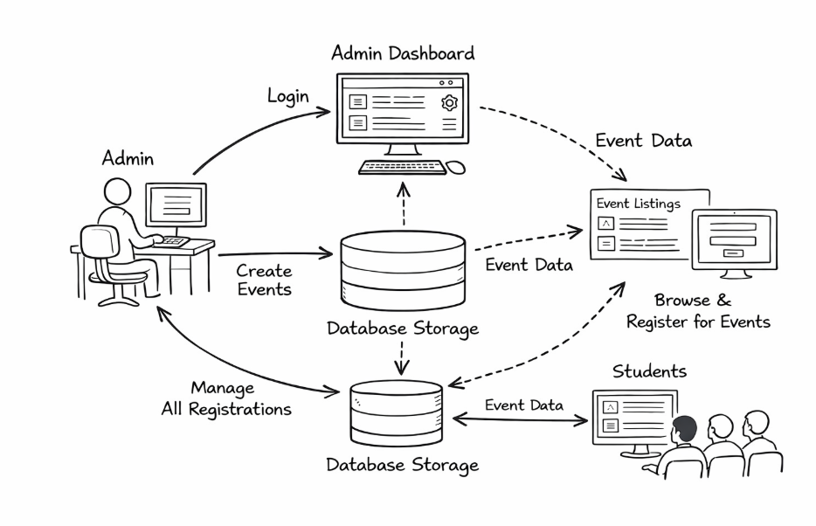
WORKFLOW
1
2
3
4
5
6
7
8
9

Slide 8
TECHNOLOGIES USED
Frontend:
HTML5
CSS3
Java script
Backend:
Node.js (v18+),
Express.js framework
Database:
MySQL 8.0
Node.js
Tools:
vs code
intellij IDEA
Software Requirements:
windows/Mac
web Browser
1
2
3
4
5
6
7
8
9

Slide 9
MODULE DESCRIPTION
----- Example for reference only ---- (Change according to your project)
Module 1: User Management
Handles full student lifecycle: registration form (name, email, student ID, dept, phone), bcrypt password hashing, session-based login/logout, and account validation with duplicate email checks.
Module 2: Event Management
Admins create events with title, description, date, location, category, max seats, and image (URL or file upload). Students browse events with live category filters and real-time seat availabilityent Management ModuEvent Management Module
Module 3: Registration Engine
Handles event registration logic: duplicate prevention (UNIQUE constraint on email+event_id), seat capacity enforcement, student dashboard with registered events, and one-click cancellation
Module 4: Admin Control Panel
Secured admin portal with separate login, live dashboard stats (total events/users/registrations), event CRUD operations, full registrations table, student roster, and individual record deletion.
1
2
3
4
5
6
7
8
9

Slide 10
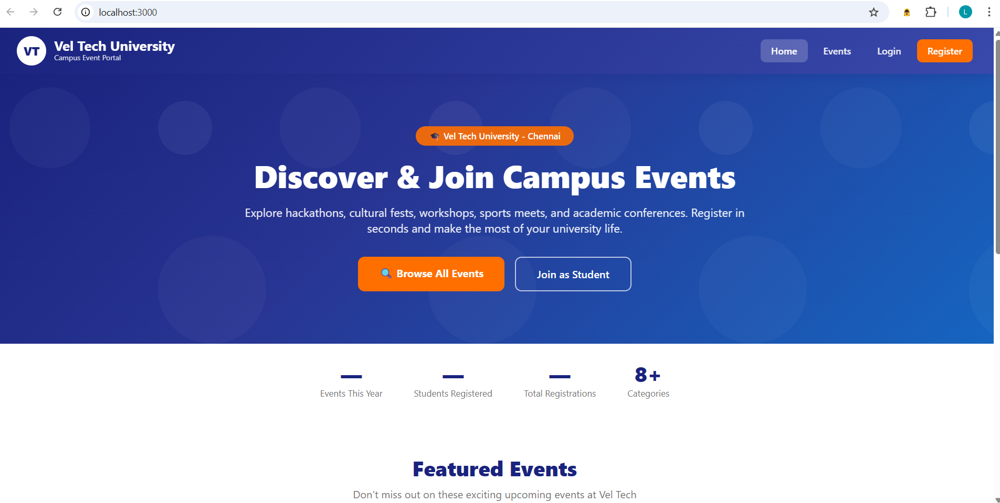
IMPLEMENTATION SCREENSHOTS
HOME PAGE:
1
2
3
4
5
6
7
8(B)
9

Slide 11
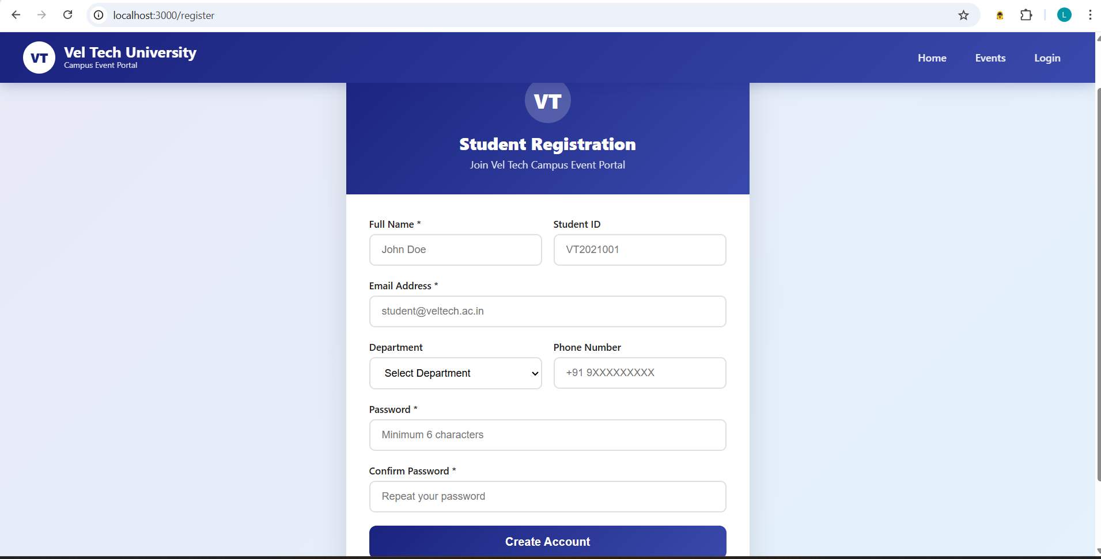
IMPLEMENTATION SCREENSHOTS
REGISTRATION PAGE:
1
2
3
4
5
6
7
8(C)
9

Slide 12
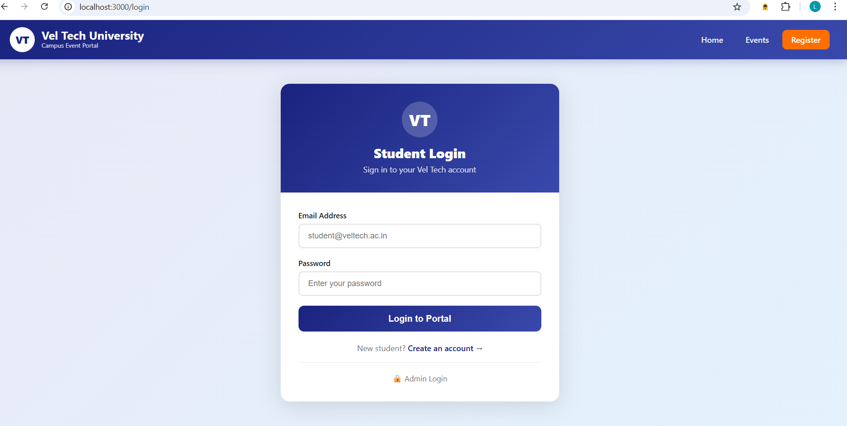
IMPLEMENTATION SCREENSHOTS
LOGIN PAGE:
1
2
3
4
5
6
7
8
9

Slide 13
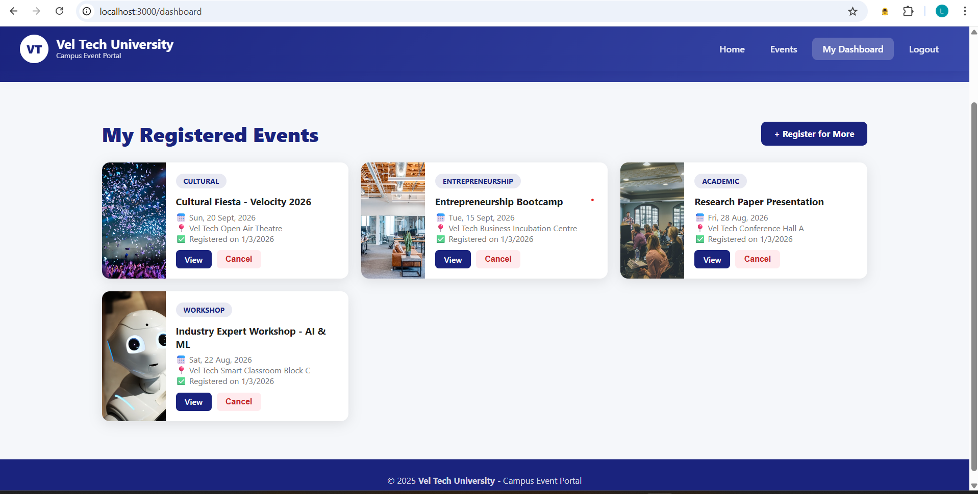
IMPLEMENTATION SCREENSHOTS
OUTPUT PAGE:
1
2
3
4
5
6
7
8(A)
9

Slide 14
ADVANTAGES & LIMITATIONS
1
Advantages
2
Easy online event registration for students.
Reduces paperwork and manual work.
Centralized management of all campus events.
Secure login system for students and admin.
Quick access to participant and event reports.
3
4
5
6
Limitations
7
Requires internet connection to access.
Limited to basic roles (Admin and Student).
No built-in payment system (if not integrated).
Performance may slow with heavy traffic.
Requires regular maintenance and updates.
8
9

Slide 15
Thank you

